Slide 1
The characterization of E. Coli driven gut microbia dysbiosis in animal models and human populations
Dr. Anthony Fodor
Associate Professor
Department of Bioinformatics
The University of North Carolina at Charlotte

Slide 2
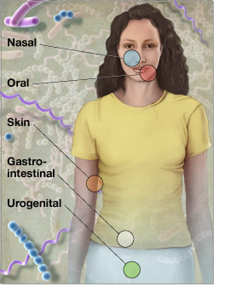
Microbes run the world!
There are 10 times more microbial
cells in our body than human cells
There are 100 times more genes
in those microbes than human genes
http://www.genome.gov/images/feature_images/nr_hmp.jpg

Slide 3
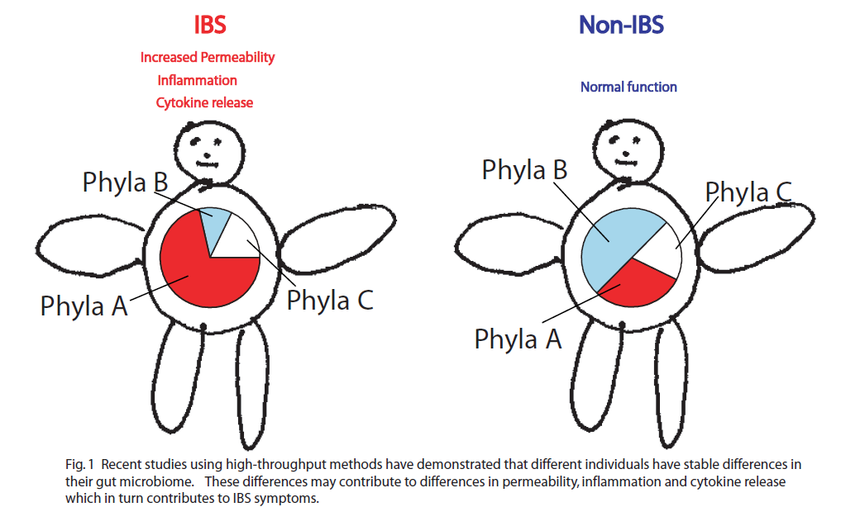
How does the microbial community impact disease? (2011)

Slide 4
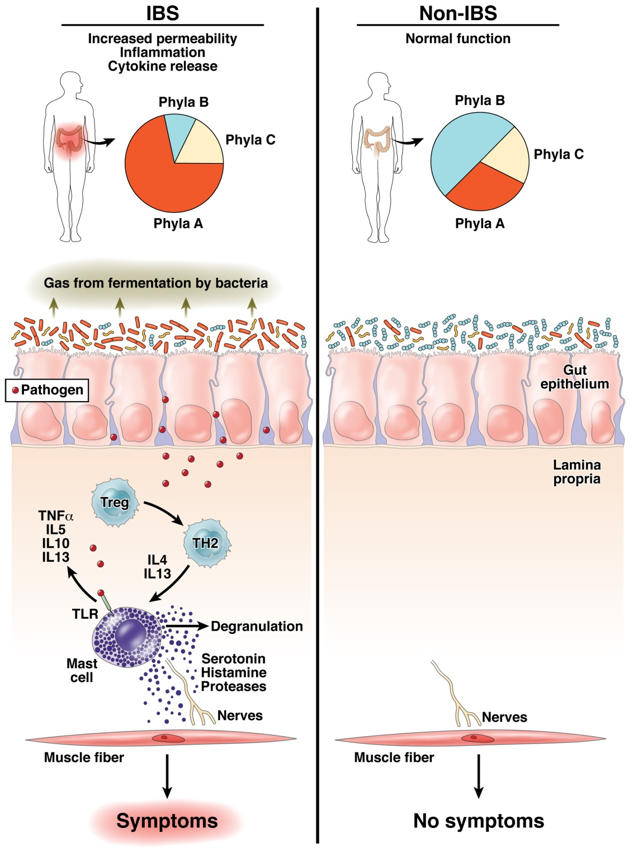
The “dysbiosis hypothesis” is central to our thinking about the role of the
microbiome in human health
Fodor & Talley. Gastroenterology. 2011

Slide 5
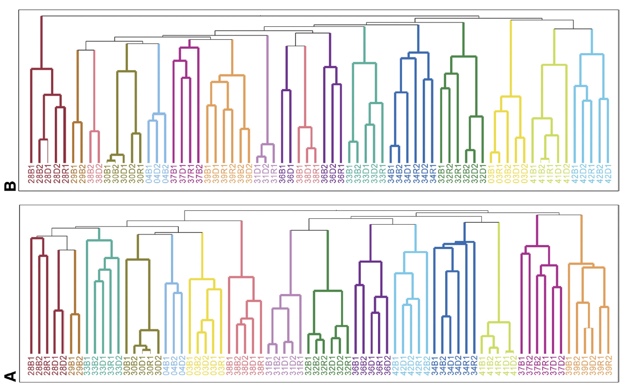
How easy it to change a microbiome?
The gut microbiome is individual, stable over time and surprisingly resistant to short-term changes in diet…
Spencer et al, Association between composition of the human gastrointestinal microbiome and development of fatty liver with choline deficiency,2011

Slide 6
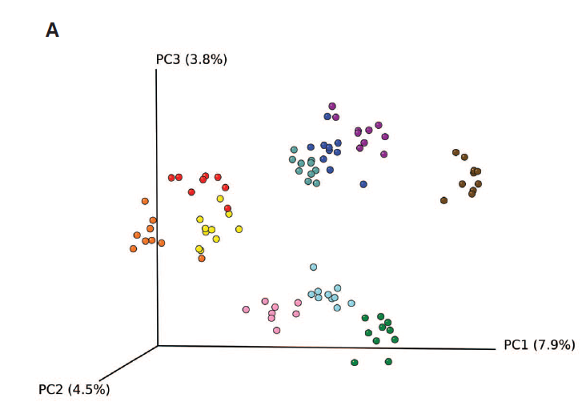
The gut microbiome is individual, stable over time and surprisingly resistant to short-term changes in diet…
Wu et.al - Linking Long-Term Dietary Patterns with Gut Microbial Enterotypes, 2011

Slide 7
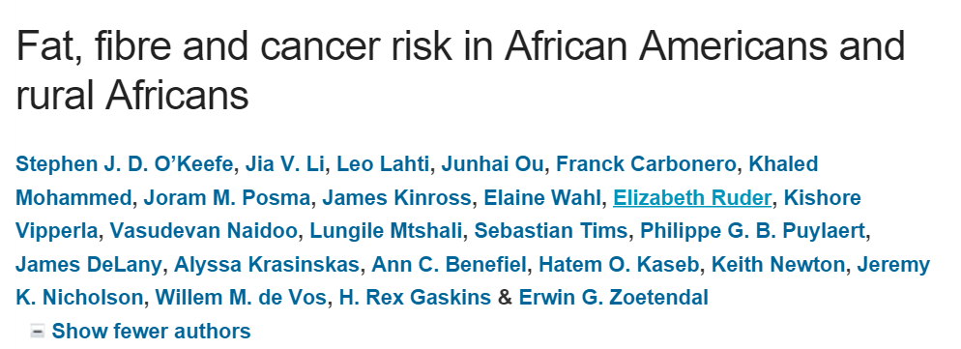
The gut microbiome is individual, stable over time and surprisingly resistant to short-term changes in diet…
Health benefits of changing diet may not be associated with big 16S changes in the microbiome!
“food changes resulted in remarkable reciprocal changes in mucosal biomarkers of cancer risk”
“the compositional changes that were specifically associated to the diet switch were minor”.

Slide 8
How important is microbial community composition?
Microbial community composition is strongly associated with obesity…

Slide 9
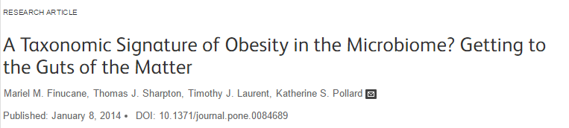
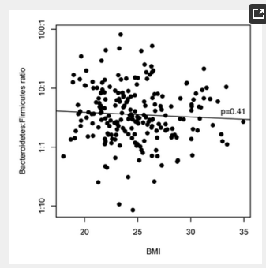
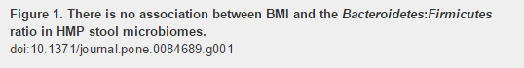
How important is microbial community composition?
Microbial community composition is strongly associated with obesity…
…. except that it never seems to be…

Slide 10
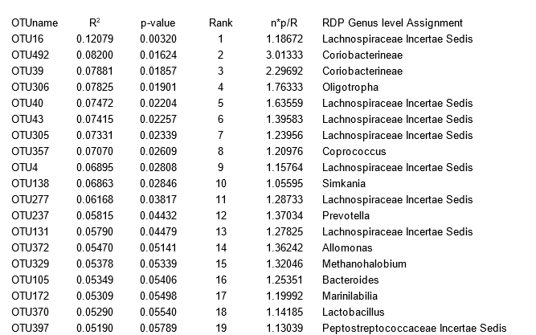
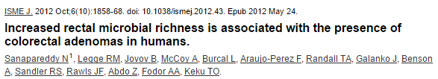
How important is microbial community composition?
Microbial community composition is strongly associated with obesity…
…. except that it never seems to be…

Slide 11
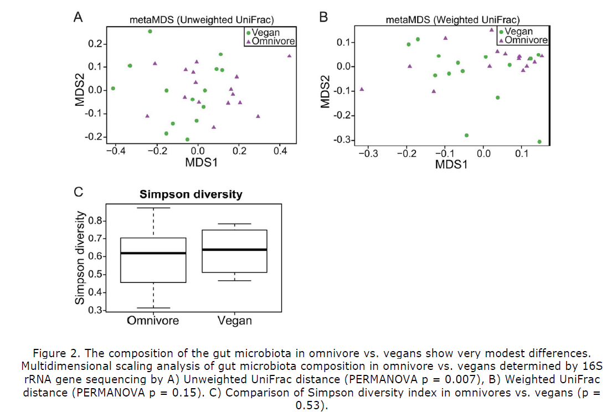
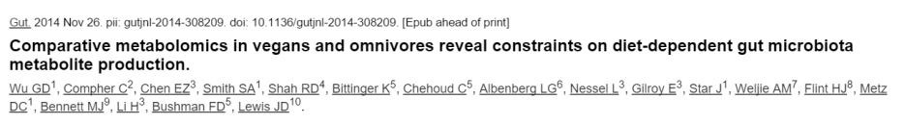
The microbiome of vegans is pretty similar to omnivores…

Slide 12
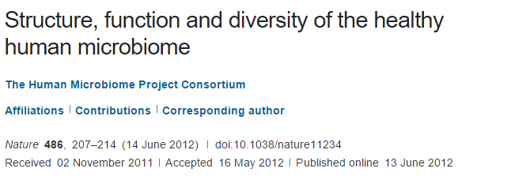
We conclude that most variation in the human microbiome is not well explained by … phenotypic metadata, and other potentially important factors such as short- and long-term diet, daily cycles, founder effects such as mode of delivery, and host genetics should be considered in future analyses.

Slide 13
Refined “dysbiosis hypothesis” (2015)
There are many, many
alternative, healthy
microbiome configurations;
Healthy variation is not
driven by the microbiome
Your individual microbiome is not so easy to change (at least with diet)
There are fewer dysbiotic states ;
Disease states can be
driven by the microbiome
Opposite of Anna Karenina
Fodor & Talley. Gastroenterology. 2011

Slide 14
An example of dysbiosis defined by one pathogen

Slide 15
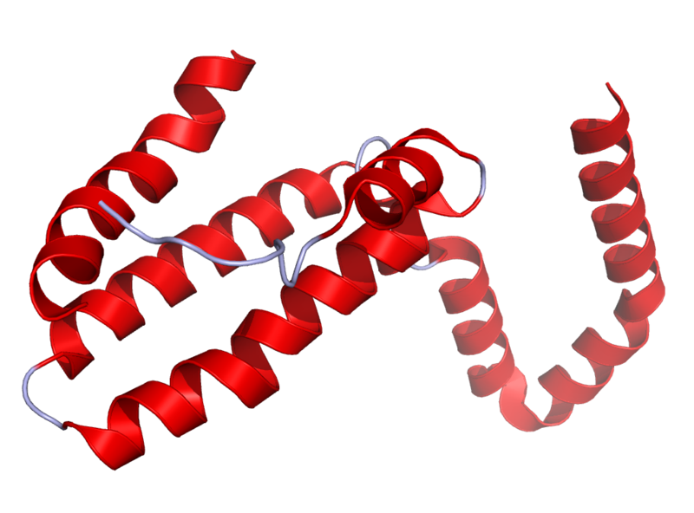
Il10^{-\-} Mouse Model
Il10 is an anti-inflammatory cytokine.
Inhibits pro inflammatory cytokines
Acts as an immunoregulator in the GI tract.
Lamblin, C., et al.,The Journal of allergy and clinical immunology, 2001.
http://en.wikipedia.org/wiki/Interleukin_10
Il10-\-
Il10^{-\-} mice are prone to inflammation with commensal tolerated by WT mice.
Knoch, B., et al.,Microbiology-Sgm, 2010
Established model for investigating disease phenotypes associated with inflammation

Slide 16
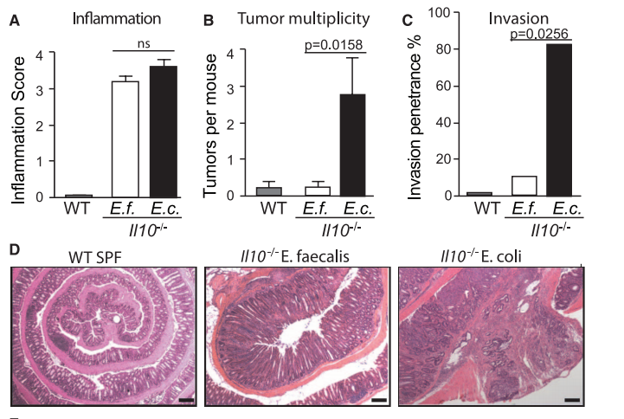
Some bugs, but not others, can cause inflammation to progress to cancer…
2012
Arthur et al, Science, 2012

Slide 17
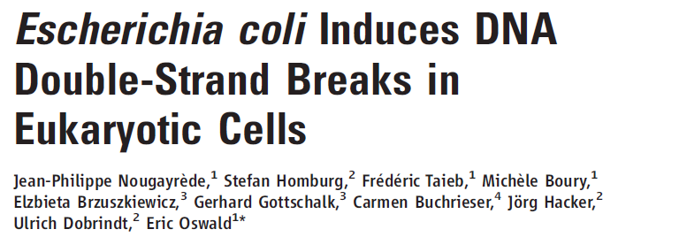
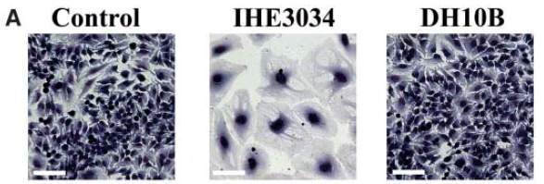
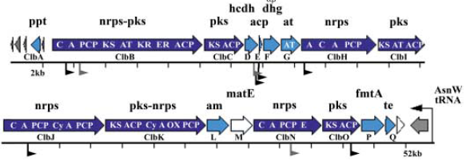
2006
Clinical E. coli isolates
change cell morphology
This activity is dependent
on the PKS island,
that encodes machinery
for polyketide and
non-ribosomal polypeptide
synthesis

Slide 18
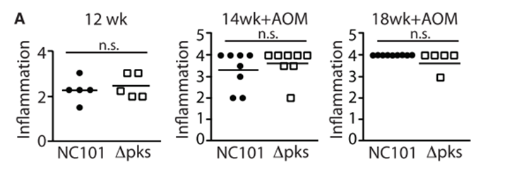
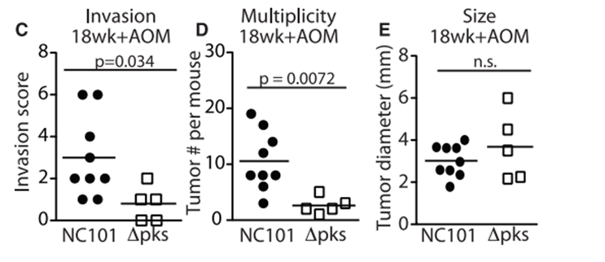
Remarkably, the PKS island appears essential in promoting progress to CRC
2006
2012

Slide 19
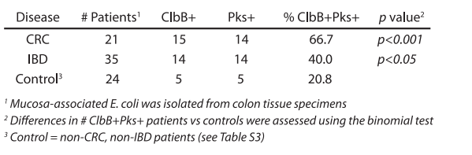
The presence of PKS is associated with cancers in multiple human cohorts
2006
2012

Slide 20
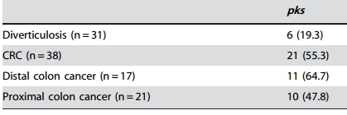
The presence of PKS is associated with cancers in multiple human cohorts
2006
2012
Buc et al - High Prevalence of Mucosa-Associated E. coli Producing
Cyclomodulin and Genotoxin in Colon Cancer (2013)
2013

Slide 21
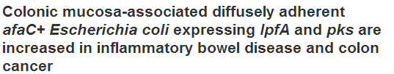
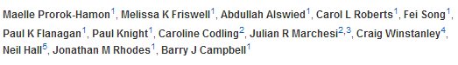
The presence of PKS is associated with cancers in multiple human cohorts
2006
2012
Buc et al - High Prevalence of Mucosa-Associated E. coli Producing
Cyclomodulin and Genotoxin in Colon Cancer (2013)
2013

Slide 22
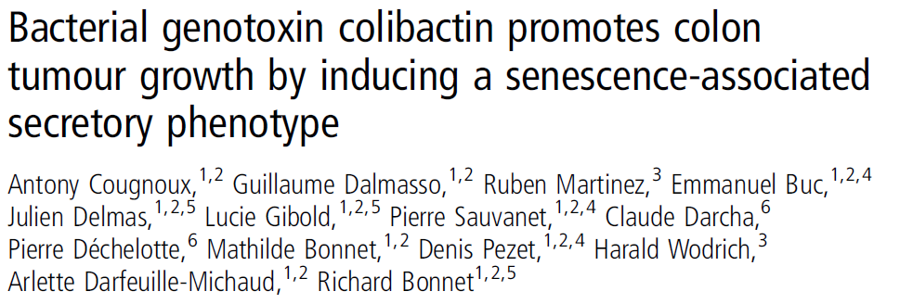
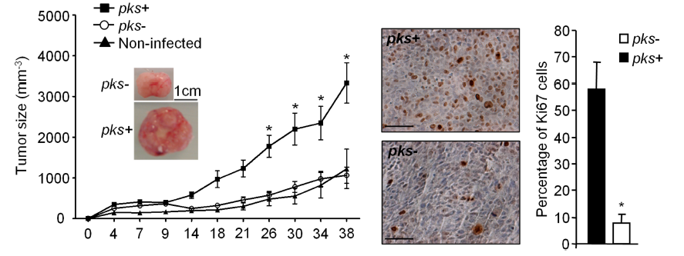
This oncogenic potential of PKS appears to be reproducible
in a HCT116 cell/ nude mouse system
2006
2012
2013
2014

Slide 23
How does the microbiome change over time in WT and inflamed animals?
6 WT cages
24 mice
5 Il10^{-\-} cages
17 mice
Illumina 16 V6 paired end sequencing of fecal samples.
Collected at 2, 12 and 20 weeks.
2x coverage by merging reads.
Clustered into OTUs
Bray-Curtis distances
PcOA (Mothur)
Mapped via blast to Silva database
Taxonomy assignment (RDP)
Arthur et al; Nature Communications; 2014

Slide 24
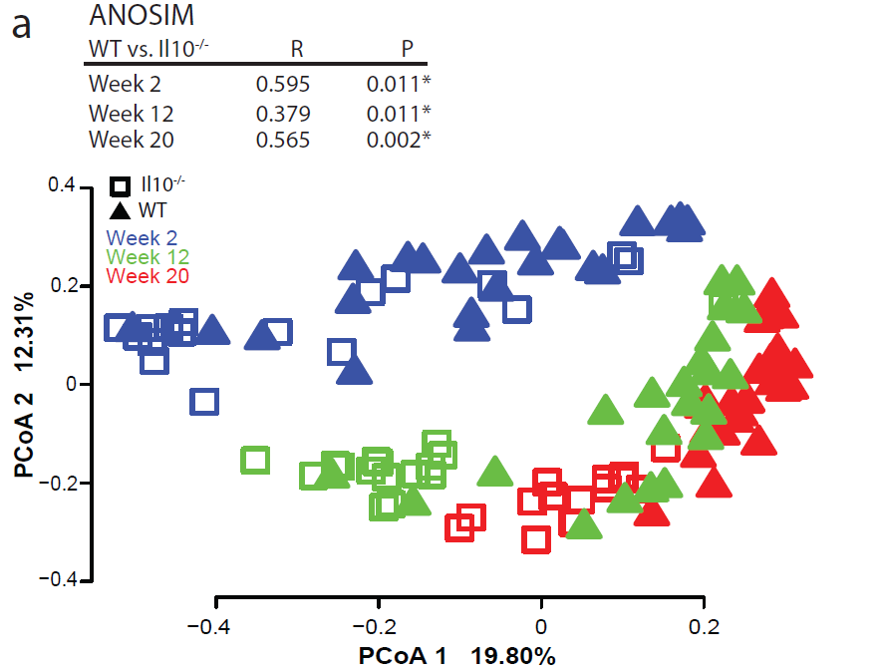
Time and inflammation are essential elements in structuring the microbial community
Arthur et al; Nature Communications; 2014

Slide 25
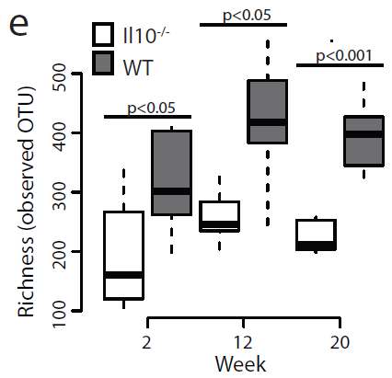
Inflammation interferes with normal succession…
Arthur et al; Nature Communications; 2014

Slide 26
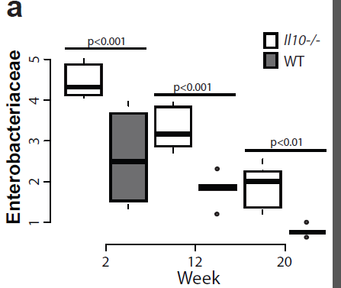
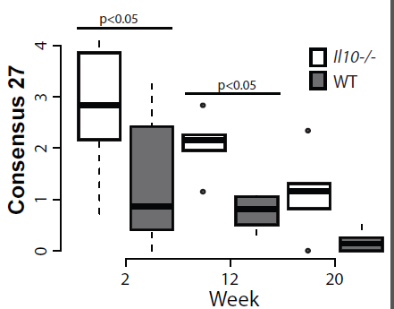
E. coli is selected against over time, but is always higher in inflamed animals
Arthur et al; Nature Communications; 2014

Slide 27
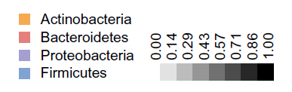
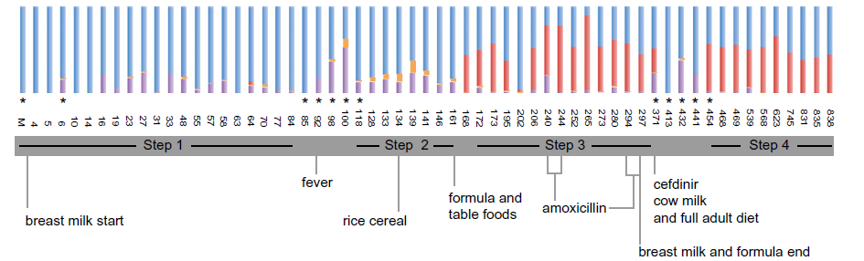
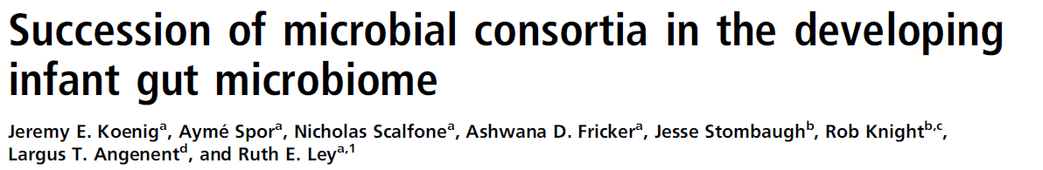
Proteobacteria selected against over time can be seen in human samples as well

Slide 28
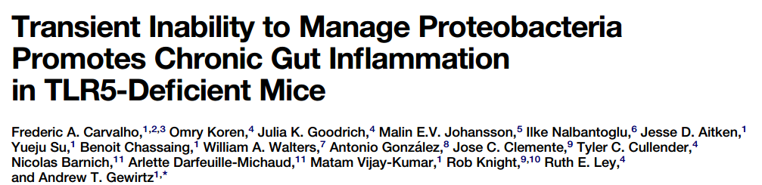
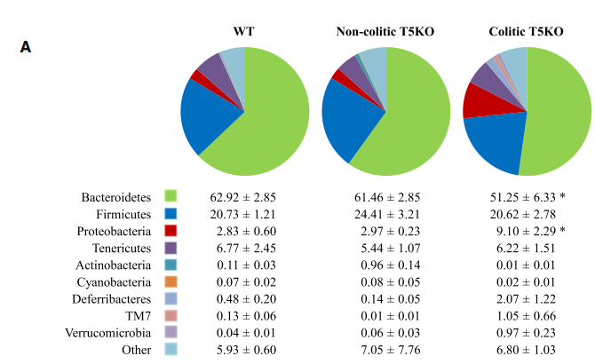
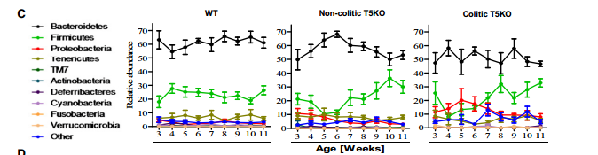
Inflammation interfering with normal succession is an emergent theme in the literature..

Slide 29
Does Westernization promote dysbiosis?

Slide 30


A related hypothesis to the dysbiosis hypothesis: the “lost microbiome” hypothesis.
Our modern Westernized microbiome is part of what contributes to disease.
We have lost beneficial bugs which we had evolved with and not have less helpful bugs…

Slide 31
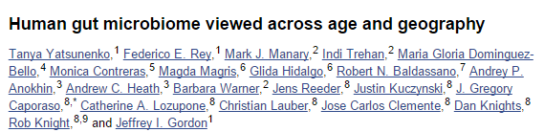
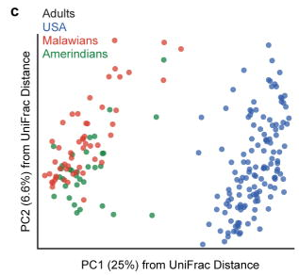
Certainly, non-Western microbiomes are very different from Western microbiomes
“healthy Amerindians from the Amazonas of Venezuela, residents of rural Malawian communities,
and inhabitants of USA metropolitan areas”

Slide 32
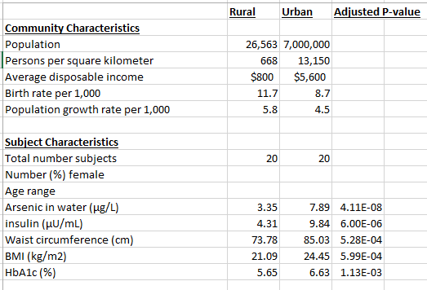
Neighboring regions in Hunan province have very different characteristics
Kathryn Winglee, Annie Green Howard, Penny Gordon-Larsen, manuscript in preparation

Slide 33
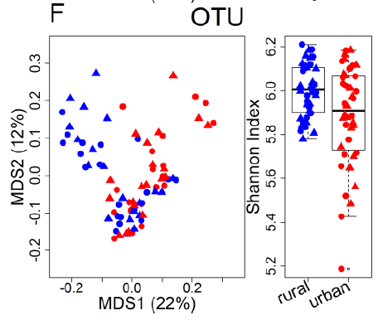
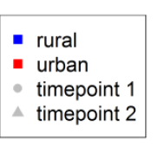
To the list of differences, we can add differences in the microbiotia
Kathryn Winglee, Annie Green Howard, Penny Gordon-Larsen, manuscript in preparation

Slide 34
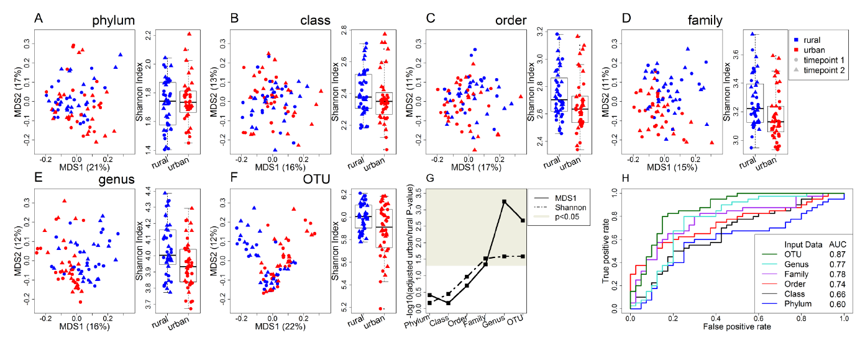
Differences constrained to lower levels of the evolutionary tree provide evidence of niche selection

Slide 35
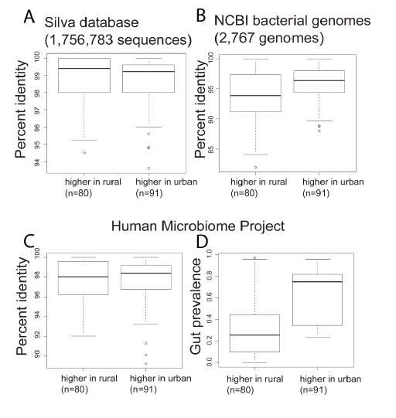
Bugs in rural China are less like U.S. bugs (and are not as well studied)

Slide 36
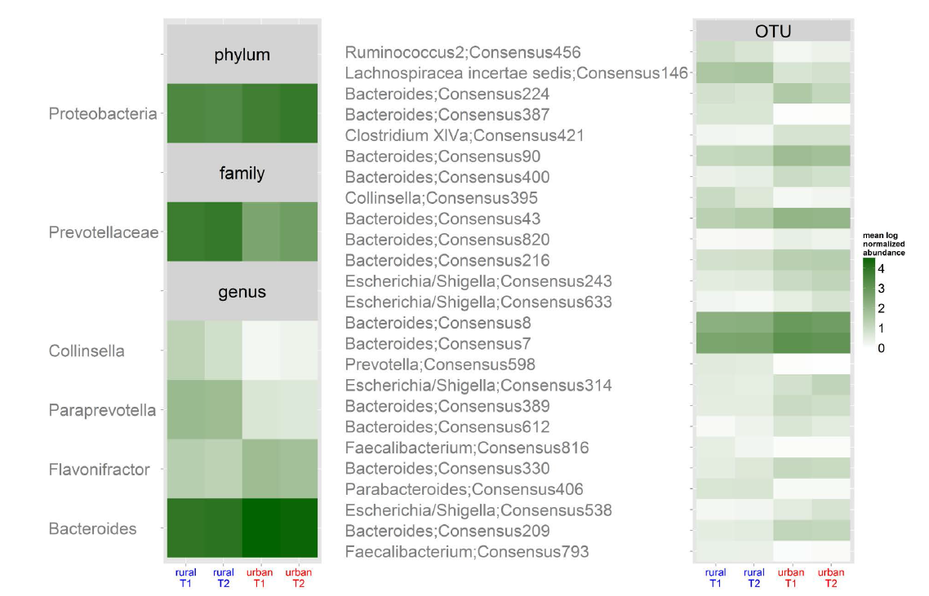
Among the bugs that are higher in urban China is genus Escherichia

Slide 37
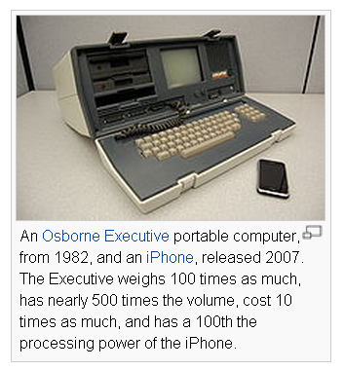
Computer then and now…
What will microbiology look like when we
can carry around whole-genome microbiome
samplers in our hand?
Will there be an iPhone sequencing app?
If you can sequence them in real time,
microbes are no longer invisible…
http://en.wikipedia.org/wiki/Moore's_law

Slide 38
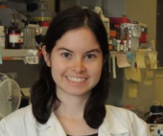




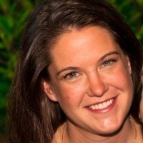



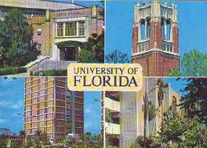


Acknowledgements
UNC-Chapel Hill
Janelle Arthur
Annie Green Howard
Marcus Muhlbauer
Penny Gordon-Larsen
UNC-Charlotte
Ra’ad Gharaibeh
Jon McCafferty
Kathryn Winglee
UF- Gainesville
Christian Jobin
Kathryn Winglee
Annie Green Howard
Penny Gordon-Larsen
Raad Gharaibeh
Jon McCafferty
Marcus Muhlbauer
Janelle Arthur
Christian Jobin

Slide 40
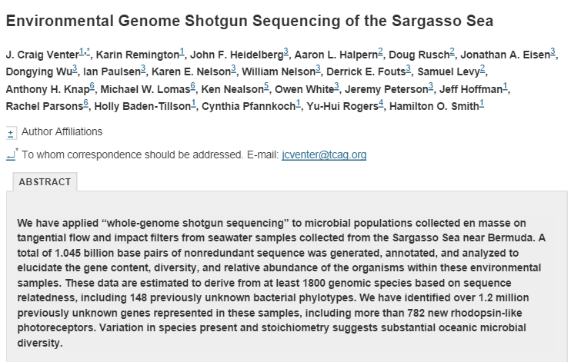
What have we learned in the last 5-7 years as sequencing has gotten cheap?
Microbial communities are complex….

Slide 41

16S variation is not necessarily reflected in whole-genome variation…

Slide 42

Progress in describing complex communities is driven by new technology
http://images.forbes.com/media/2010/06/03/0603_chart-cost-human-genome_398x371.jpg
What have we learned in the last 5-7 years as sequencing has gotten cheap?

Slide 43


What have we learned in the last 5-7 years as sequencing has gotten cheap?
Microbial communities are complex….

Slide 44

Establishing what is and is not directly driven by the microbiome is becoming increasingly urgent
Negative result are very important!

Slide 45

Establishing what is and is not directly driven by the microbiome is becoming increasingly urgent
Negative result are very important!

Slide 46

Establishing what is and is not directly driven by the microbiome is becoming increasingly urgent
Negative result are very important!

Slide 47

Longitudinal sampling is very important

